Slide 1
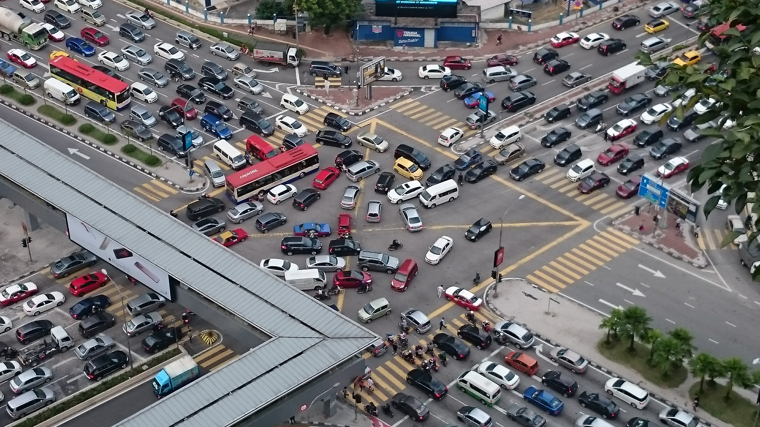
“Intelligent Traffic Lights Control By Fuzzy Logic” Tan, Khalid, Yusof
Ease traffic congestion by mimicking human intelligence
Notes:
“Intelligent Traffic Lights Control By Fuzzy Logic”
- Tan, Khalid, Yusof (1996)
* Seek to address emerging traffic congestion problem
* In Kuala Lumpur, Malaysia resulted to using traffic policement during peak hours
* Propose Fuzzy Logic implementation to mimic human intelligence
* Image from 2016 on unhappiness of Malaysian motorists

Slide 2
Agenda
Fuzzy Controller Design
Author’s Results
Traffic Controller Simulations
Simulation Results
Conclusions
Q&A

Slide 3
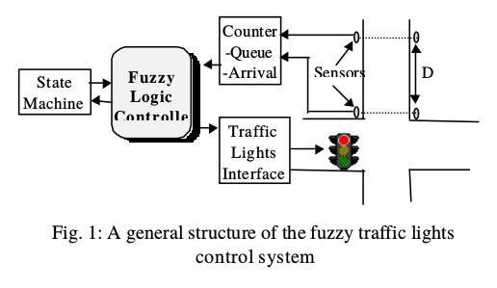
Fuzzy Controller
Fuzzy Controller “counts” waiting cars
Green light time varies from 2-20 seconds
Notes:
* Fuzzy system replaces 1 of 2 typical implementations
** Fixed timing
** EM sensor which triggers light change (requires a priori knowledge of flow patterns)
* New system uses 2 sensors
** First counts cars entering the intersection, second counts cars approaching the intersection
** Number of cars “at” intersection is difference

Slide 4
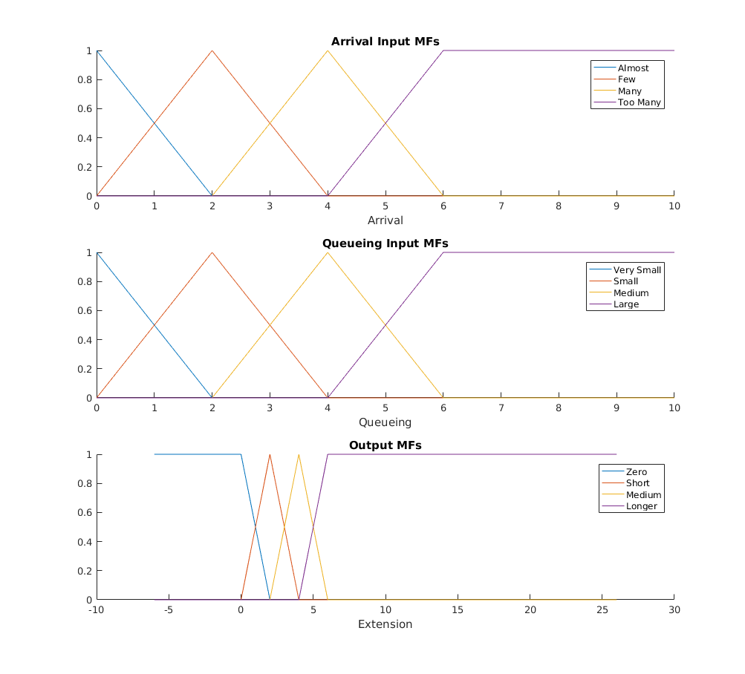
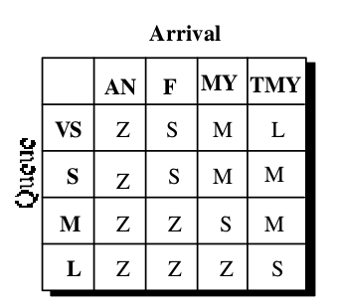
Controller Design
Notes:
* Controller considers number of cars moving through green and number of cars waiting at red
** Cars moving through green = Arrival
** Cars waiting at red = Queue
* Authors used max-min inference with COA defuzzification
* I used Sum-min inference engine (approximation) with COA defuzzification

Slide 5
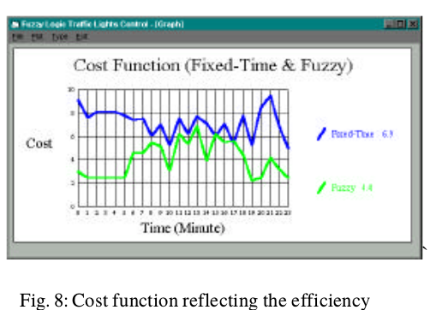
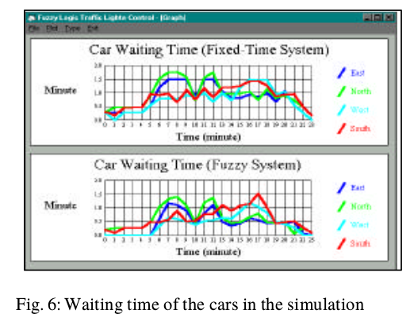
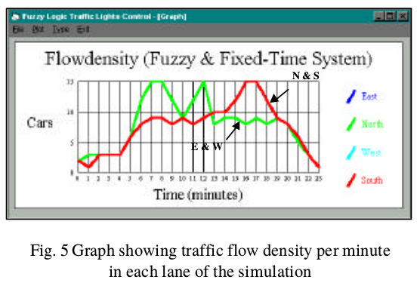
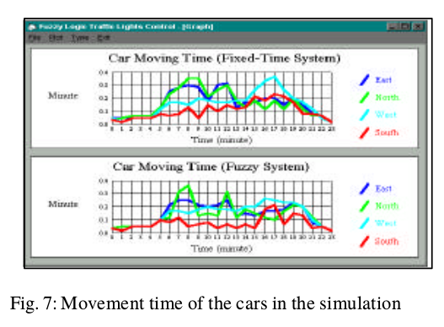
Authors’ Results
Notes:
Flow Density:
Rate = Cars / Time
Cost Function:
Cost = (Cars In * Wait Time) / (Cars Out * Drive Time)

Slide 6
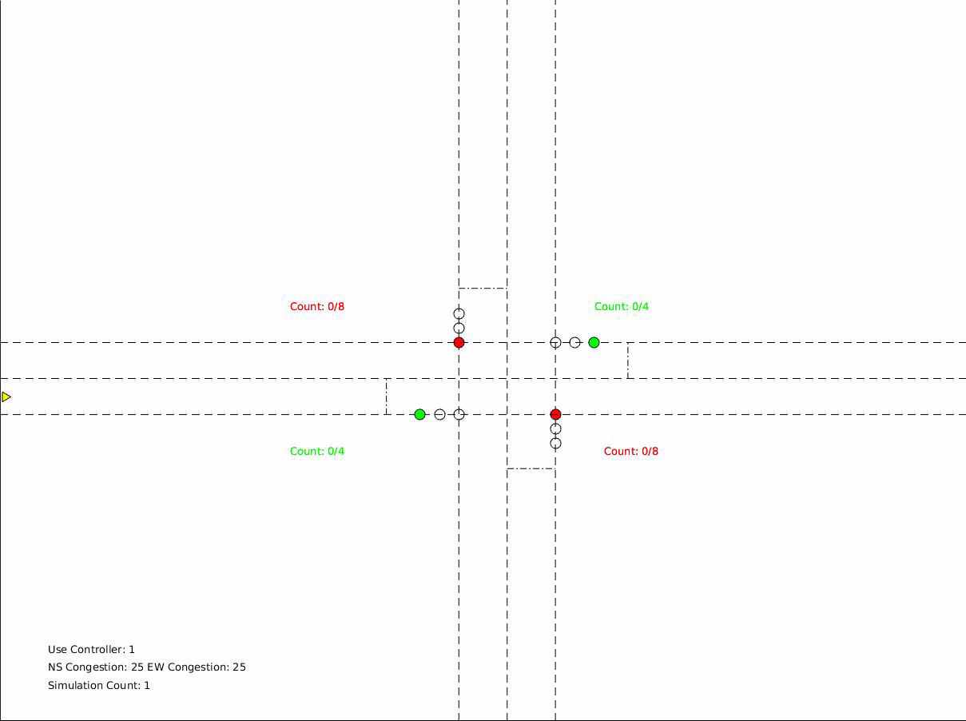
Simulation
Notes:
* Simulation of N,S,E,W lanes through single intersection
** no turns
** green light time varies from 2-20 “counts”
** Congestion = 0.25 for all lanes
* Sensors placed to allow up to 8 “queued” cars
* Video using fuzzy controller

Slide 7
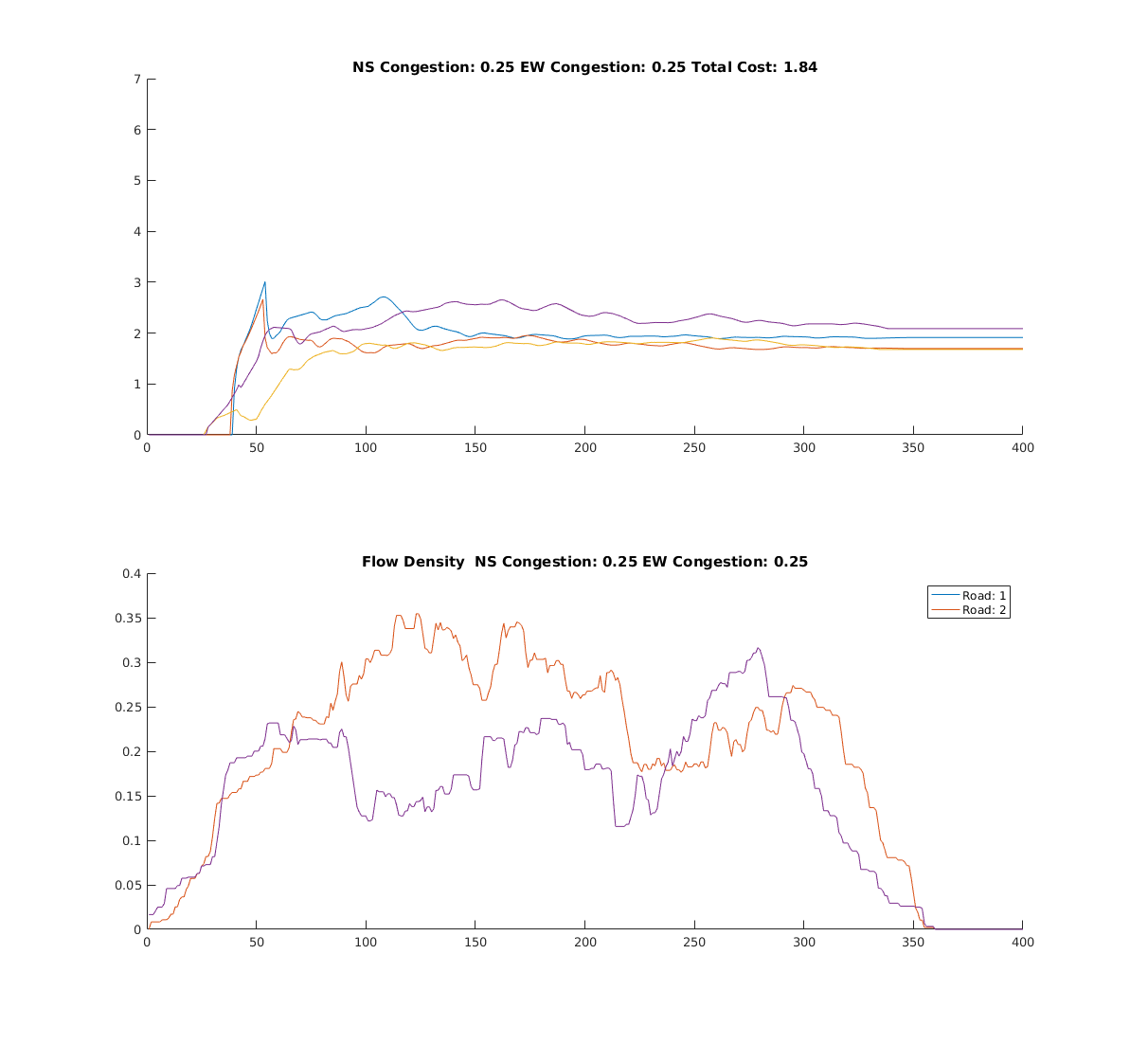
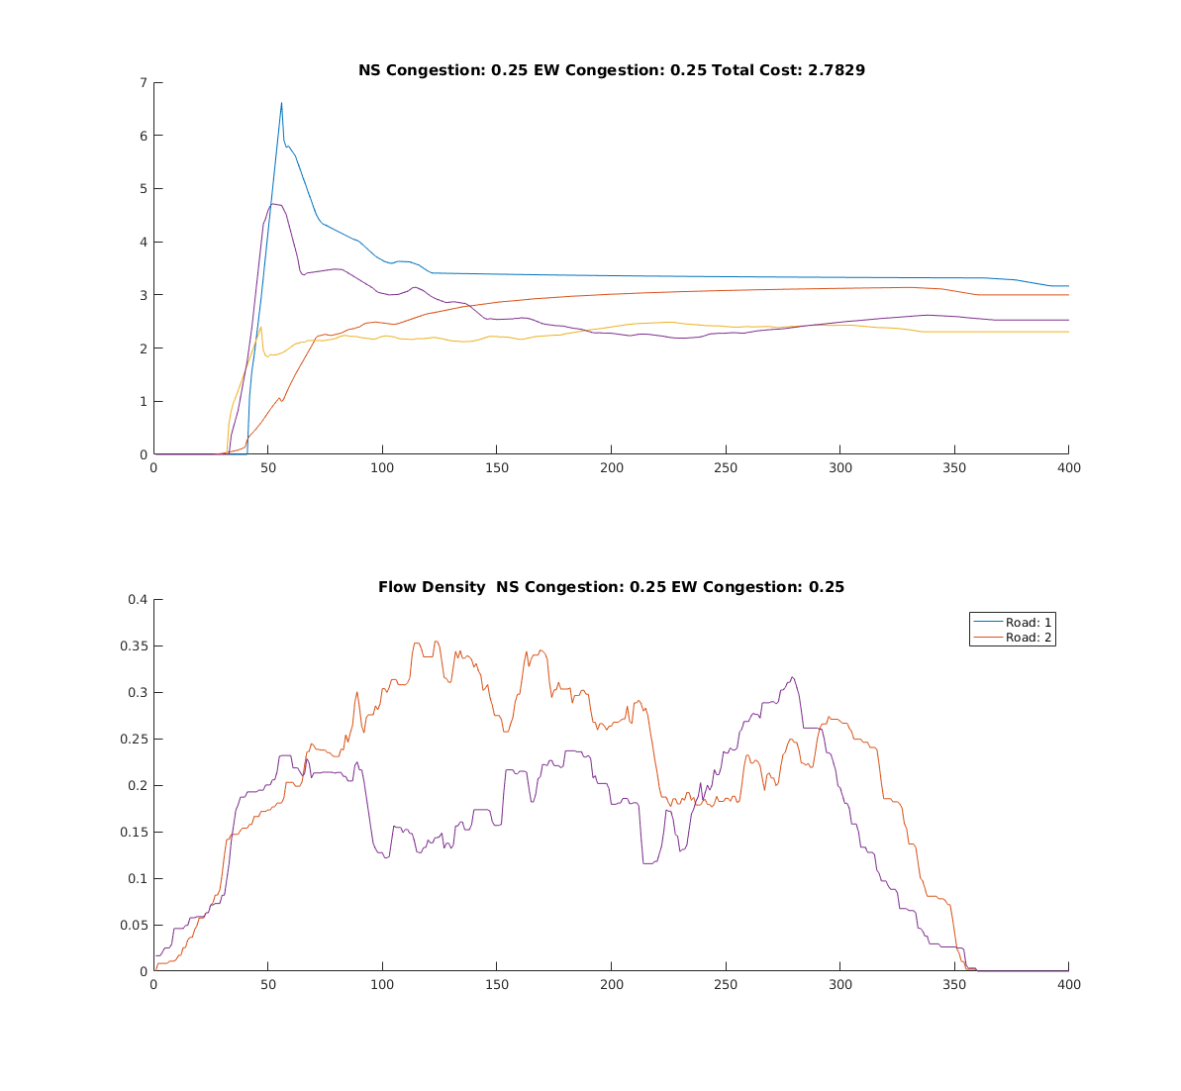
Fuzzy vs Fixed
Notes:
* Cost 30% lower for fuzzy
* High congestion exacerbates problem with fixed controller

Slide 8
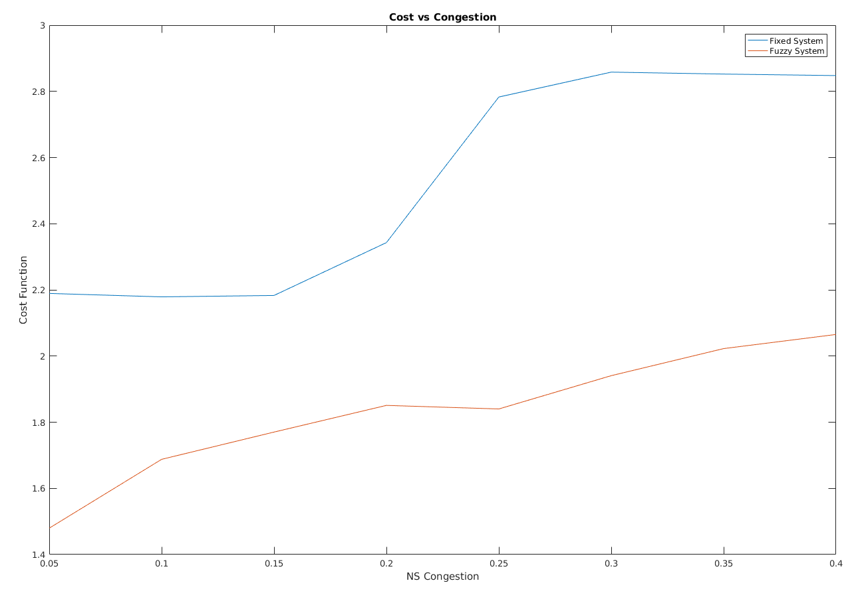
Cost vs NS Congestion EW Congestion=0.25
Notes:
* Fuzzy controller performs better at all congestion levels
* Fixed system “saturates” at 30% congestion

Slide 9
Conclusions
Researchers developed fuzzy controller for intelligently controlling traffic light based on congestion
Fuzzy controller performs better across the board
Fuzzy controller easily adapts to changing traffic conditions

